Slide 1

COMPUTER NETWORKS
(BCSC 0008)
Copyright content, use only with the written permission of presenter mentioned
Lecture 21

Slide 2
Text and Reference Books
Text Books:
Fourouzan B. A. (2004), “Data Communication and Networking”, 4th Edition, McGraw-Hill.
References:
Kurose, J. F. and Ross K. W. (2005), “Computer Networking: A Top-Down Approach Featuring the Internet”, 3rd Edition, Addison-Wesley.
A. S. Tanenbaum (2006), “Computer Networks”, 2nd Edition, Prentice Hall India.

Slide 3
22-1 DELIVERY
The network layer supervises the handling of the packets by the underlying physical networks. We define this handling as the delivery of a packet.
Topics discussed in this section:
Direct Versus Indirect Delivery

Slide 4
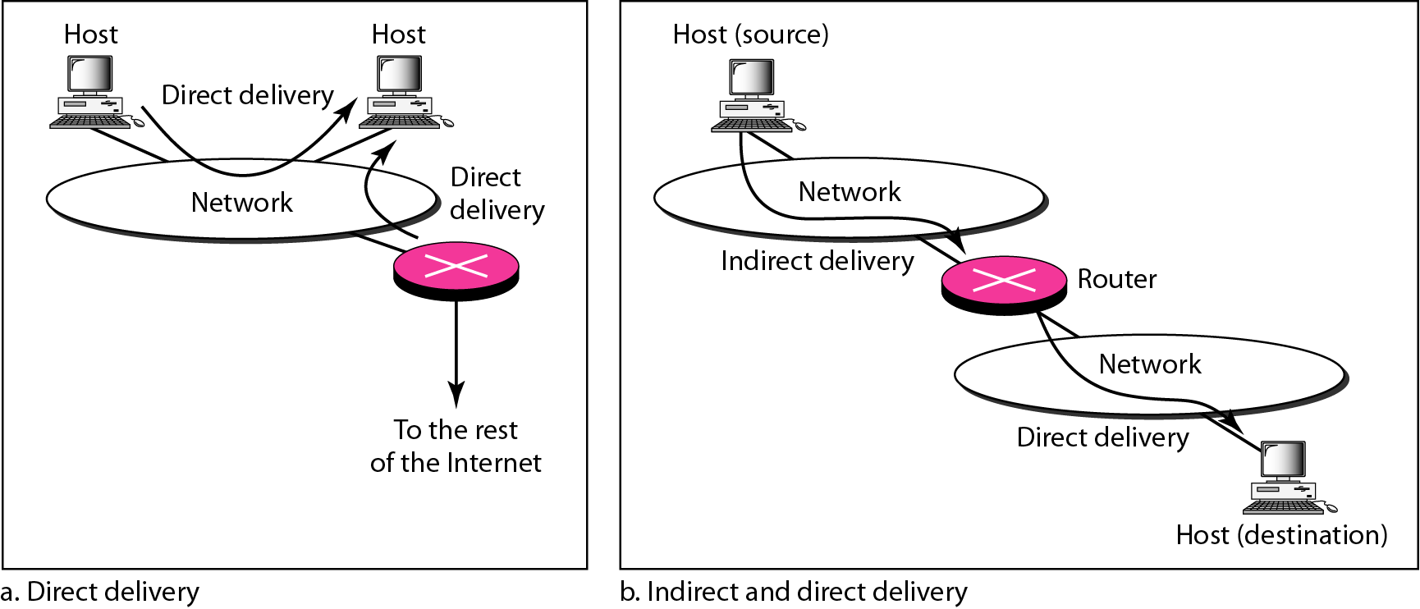
Figure 22.1 Direct and indirect delivery

Slide 5
22-2 FORWARDING
Forwarding means to place the packet in its route to its destination. Forwarding requires a host or a router to have a routing table. When a host has a packet to send or when a router has received a packet to be forwarded, it looks at this table to find the route to the final destination.
Topics discussed in this section:
Forwarding Techniques
Forwarding Process
Routing Table

Slide 6
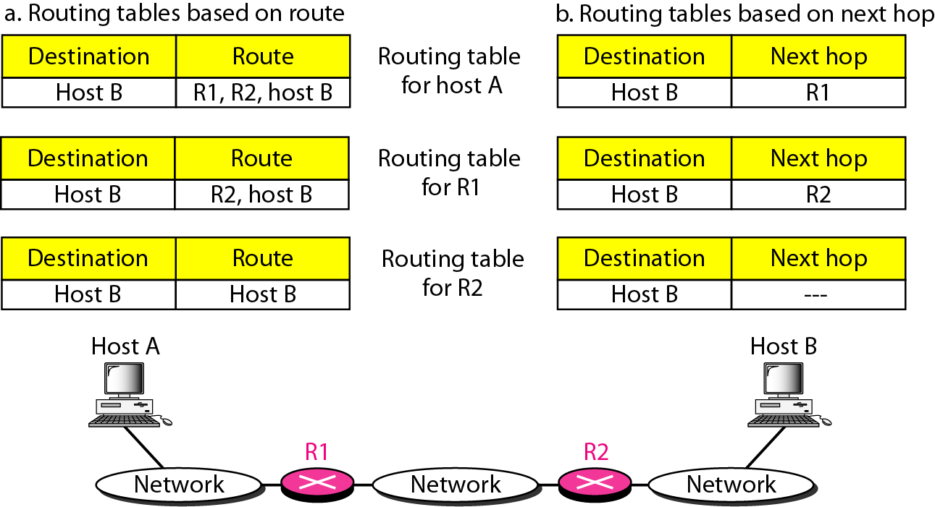
Figure 22.2 Route method versus next-hop method

Slide 7
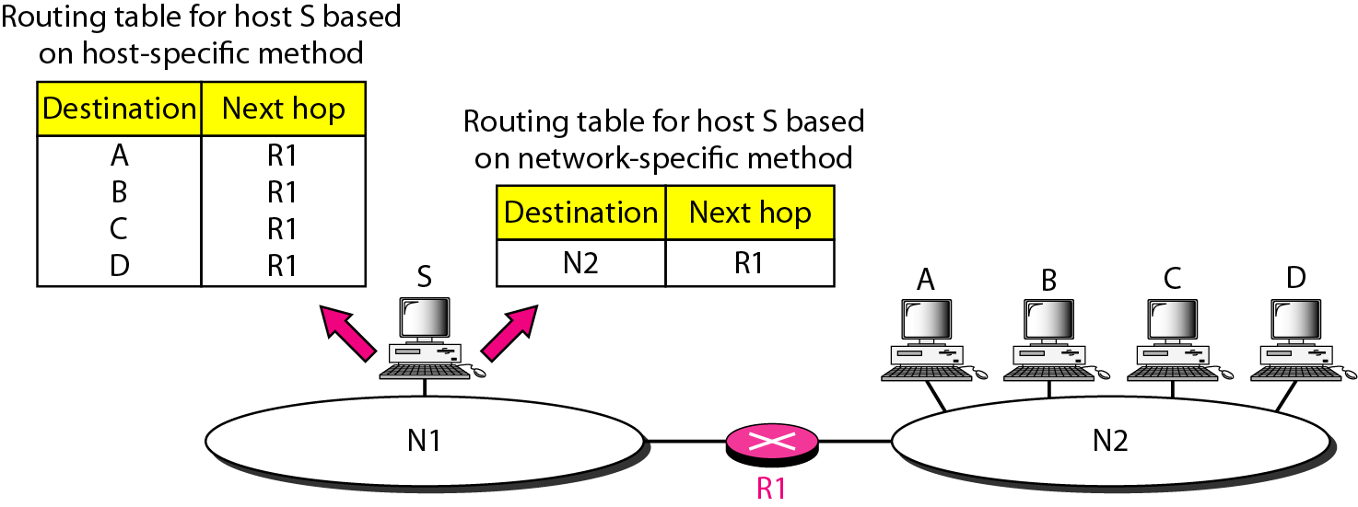
Figure 22.3 Host-specific versus network-specific method

Slide 8
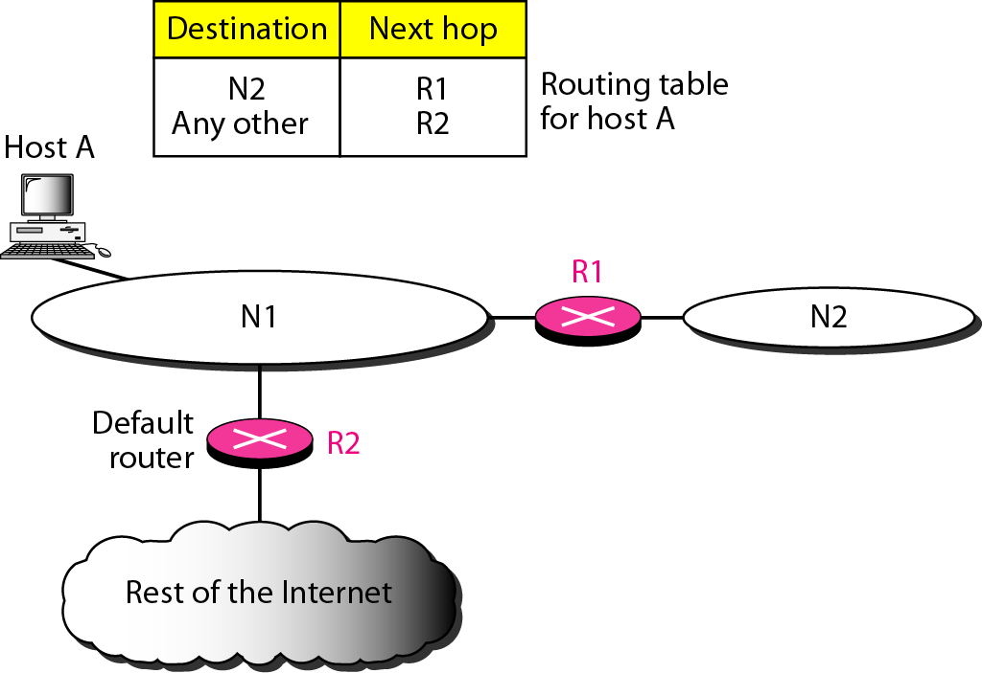
Figure 22.4 Default method

Slide 9
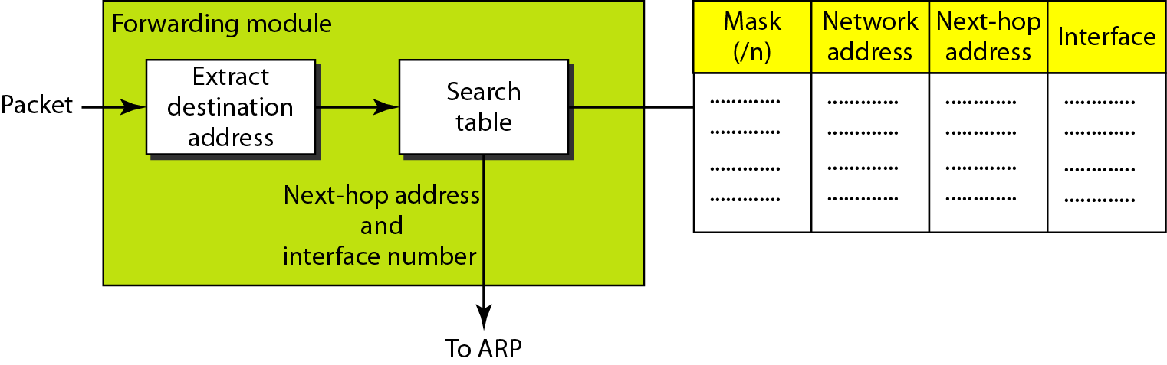
Figure 22.5 Simplified forwarding module in classless address

Slide 10
Example 22.1
Make a routing table for router R1, using the configuration in Figure 22.6.
Solution
Table 22.1 shows the corresponding table.

Slide 11
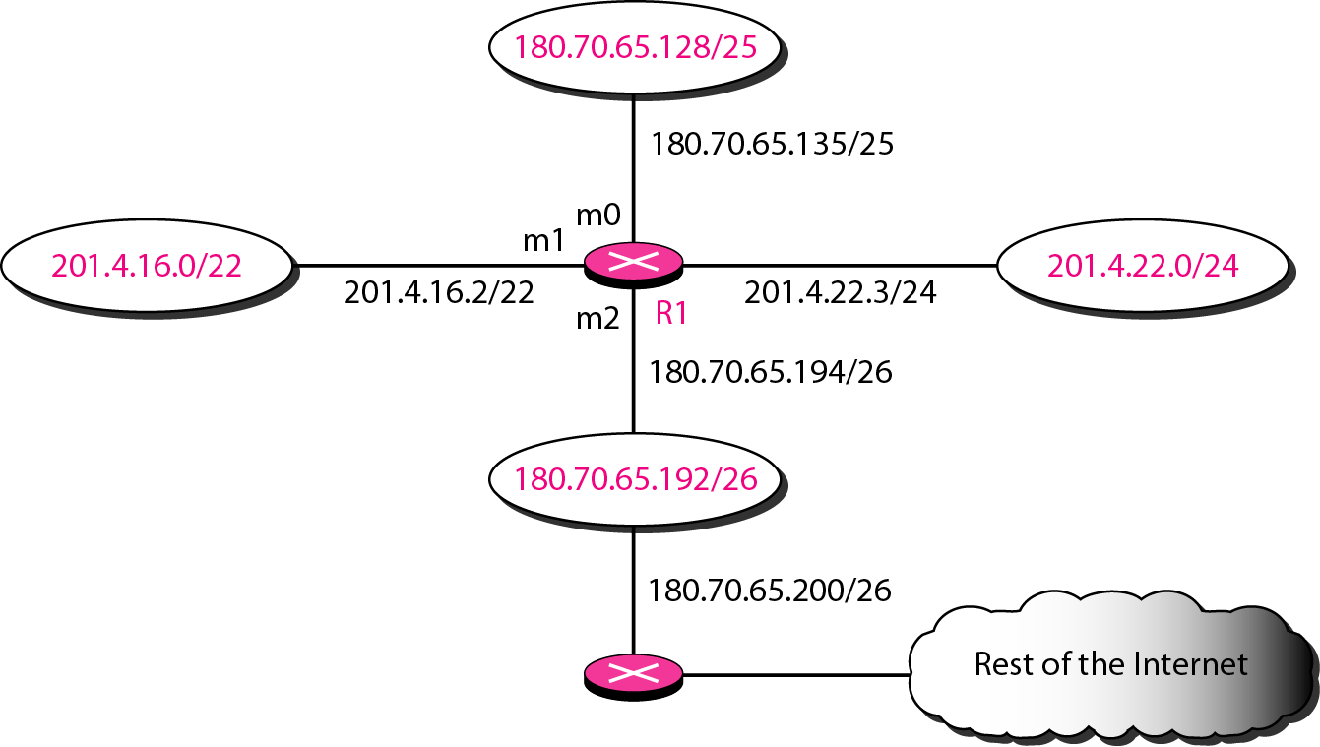
Figure 22.6 Configuration for Example 22.1

Slide 12
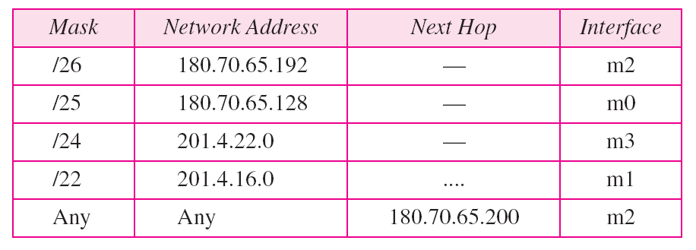
Table 22.1 Routing table for router R1 in Figure 22.6

Slide 13
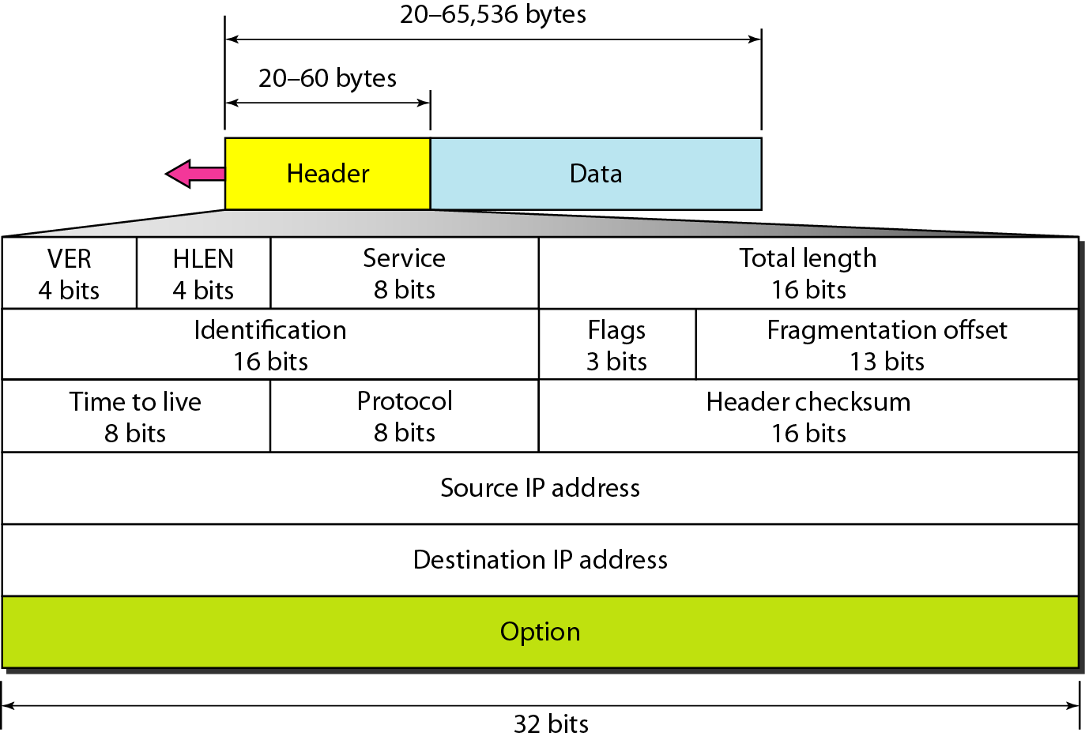
Figure 20.5 IPv4 datagram format

Slide 14
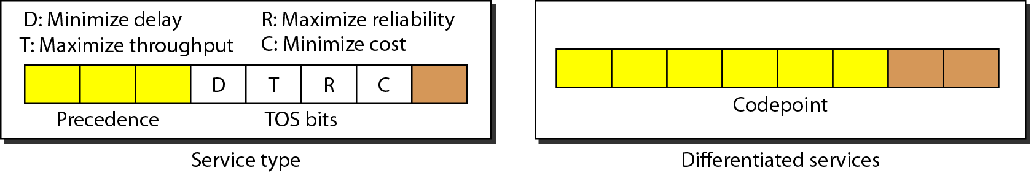
Figure 20.6 Service type or differentiated services

Slide 15

Note
The precedence subfield was part of version 4, but never used.

Slide 16
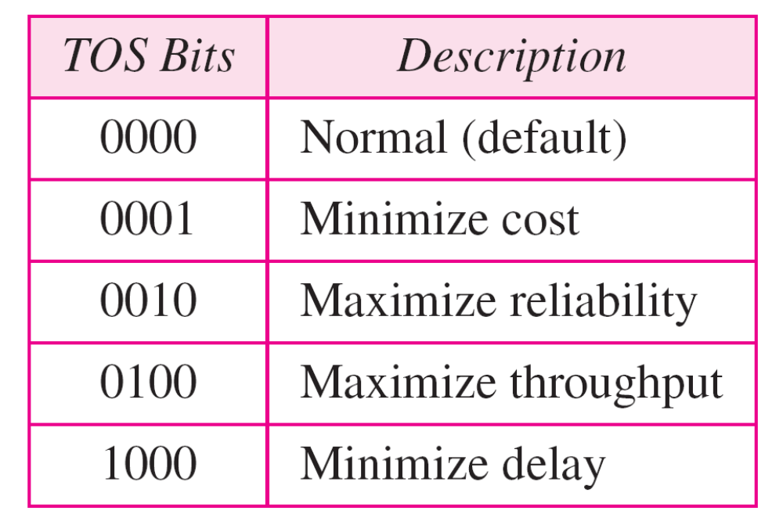
Table 20.1 Types of service

Slide 17
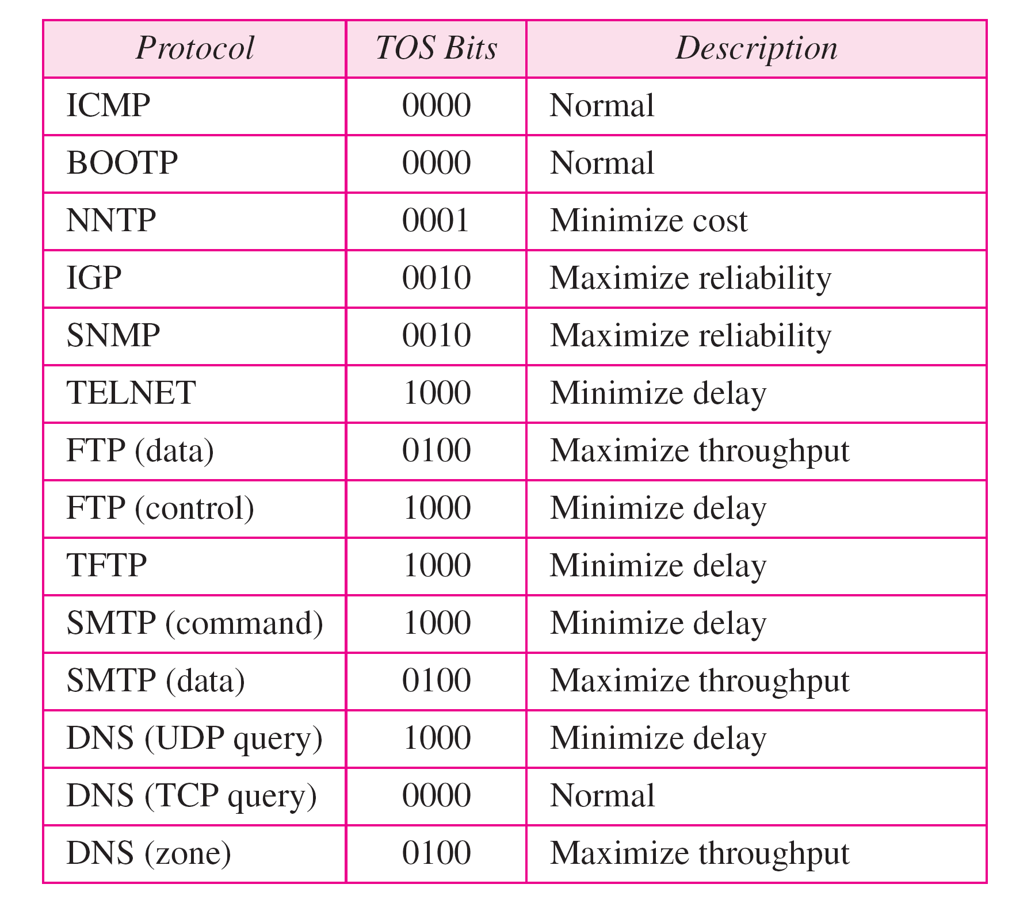
Table 20.2 Default types of service

Slide 18
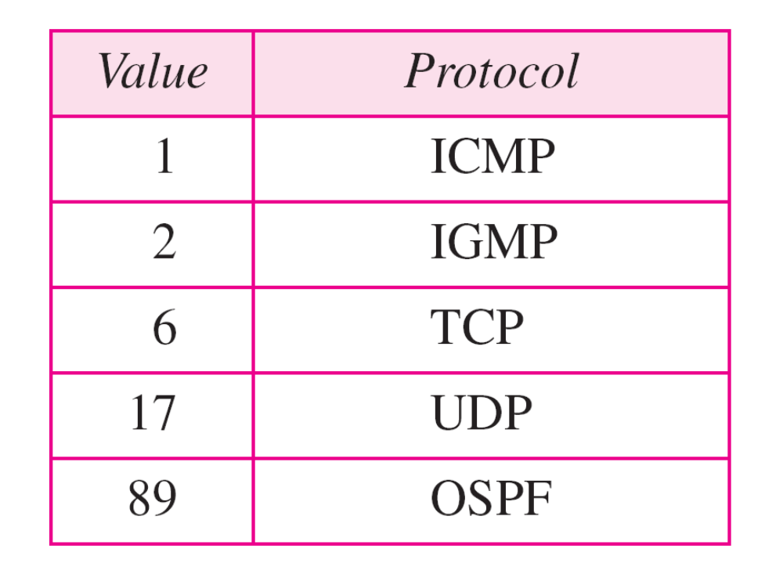
Table 20.3 Values for codepoints

Slide 19
Note
The total length field defines the total length of the datagram including the header.

Slide 20
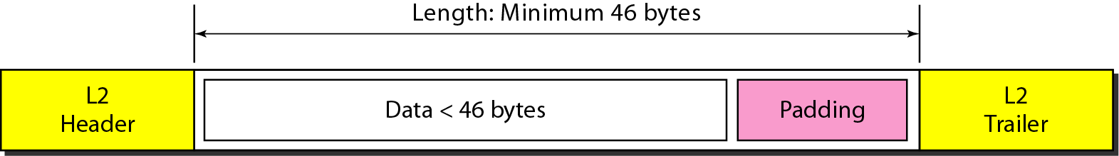
Figure 20.7 Encapsulation of a small datagram in an Ethernet frame

Slide 21
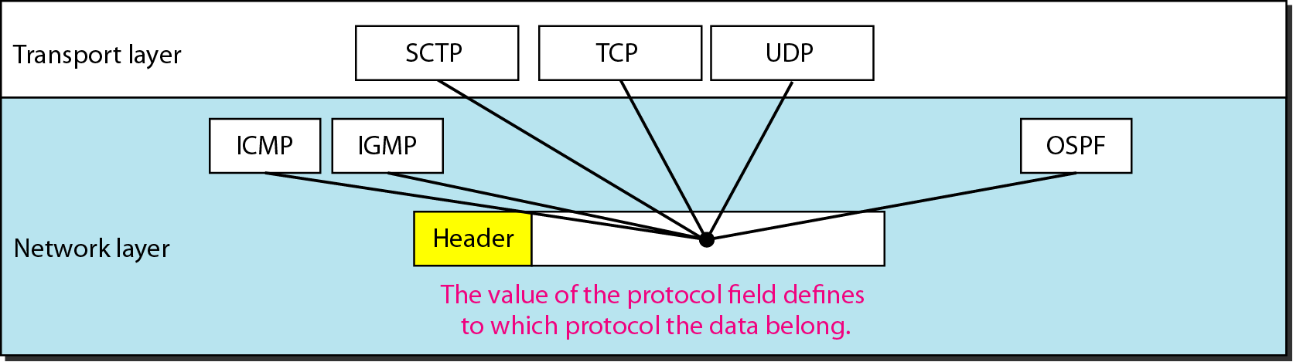
Figure 20.8 Protocol field and encapsulated data

Slide 22
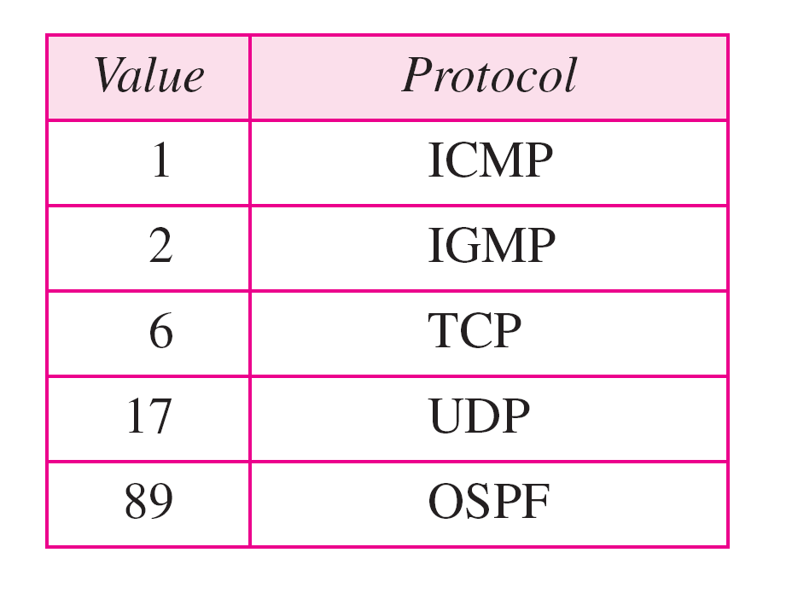
Table 20.4 Protocol values

Slide 23
Example 20.1
An IPv4 packet has arrived with the first 8 bits as shown:
01000010
The receiver discards the packet. Why?
Solution
There is an error in this packet. The 4 leftmost bits (0100) show the version, which is correct. The next 4 bits (0010) show an invalid header length (2 × 4 = 8). The minimum number of bytes in the header must be 20. The packet has been corrupted in transmission.

Slide 24
Example 20.2
In an IPv4 packet, the value of HLEN is 1000 in binary. How many bytes of options are being carried by this packet?
Solution
The HLEN value is 8, which means the total number of bytes in the header is 8 × 4, or 32 bytes. The first 20 bytes are the base header, the next 12 bytes are the options.

Slide 25
Example 20.3
In an IPv4 packet, the value of HLEN is 5, and the value of the total length field is 0x0028. How many bytes of data are being carried by this packet?
Solution
The HLEN value is 5, which means the total number of bytes in the header is 5 × 4, or 20 bytes (no options). The total length is 40 bytes, which means the packet is carrying 20 bytes of data (40 − 20).

Slide 26
Example 20.4
An IPv4 packet has arrived with the first few hexadecimal digits as shown.
0x45000028000100000102 . . .
How many hops can this packet travel before being dropped? The data belong to what upper-layer protocol?
Solution
To find the time-to-live field, we skip 8 bytes. The time-to-live field is the ninth byte, which is 01. This means the packet can travel only one hop. The protocol field is the next byte (02), which means that the upper-layer protocol is IGMP.

Slide 27
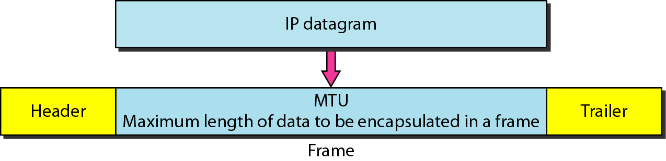
Figure 20.9 Maximum transfer unit (MTU)

Slide 28
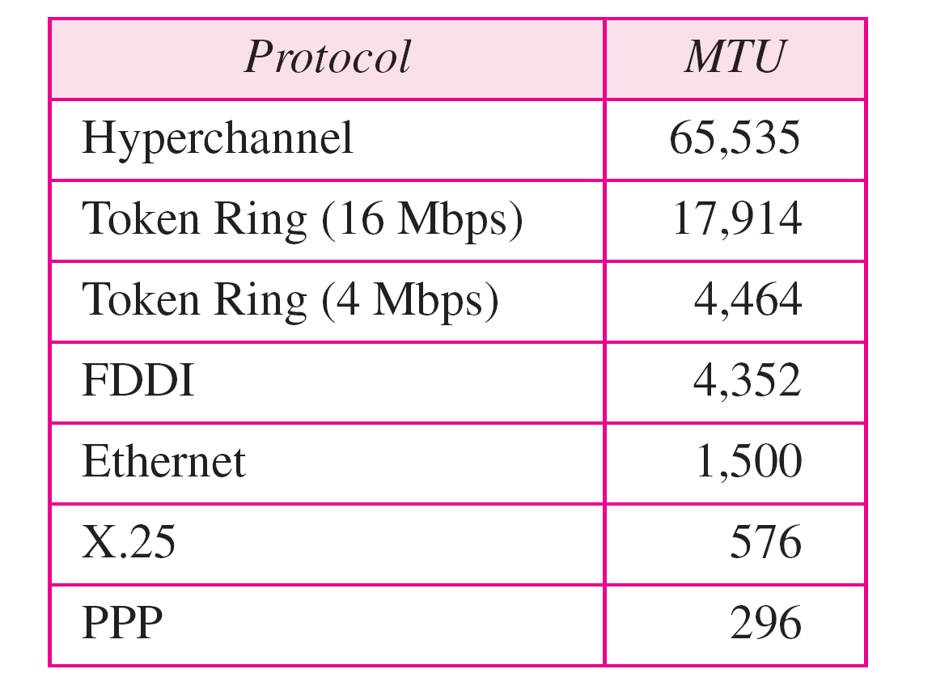
Table 20.5 MTUs for some networks

